Slide 1
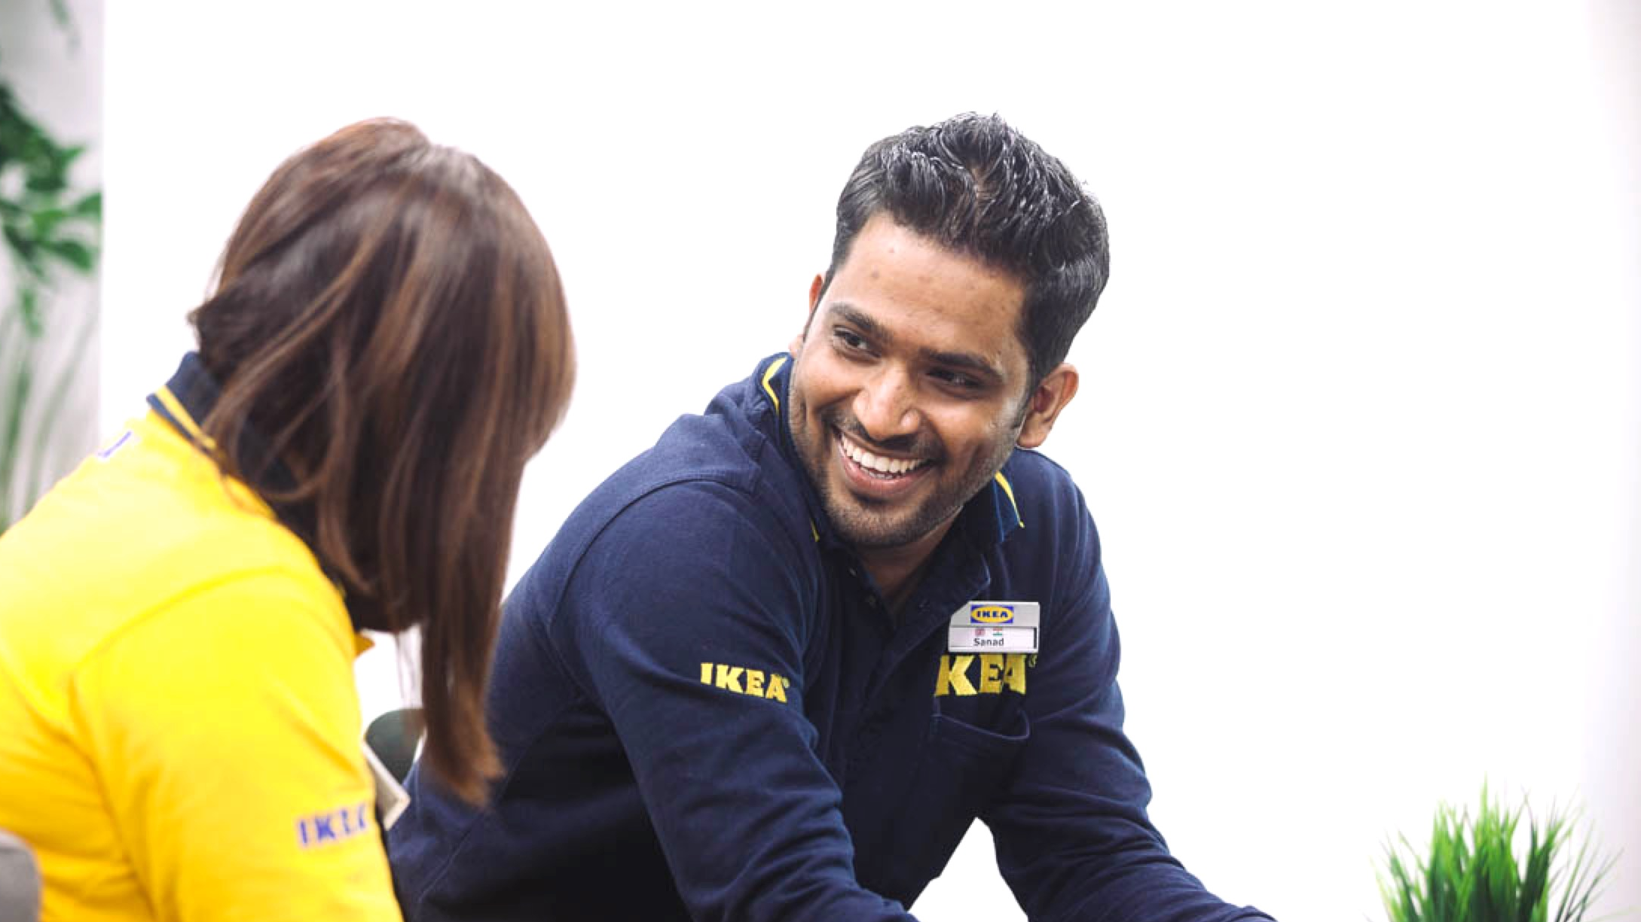



Setting
goals
Notes:
Trainer’s notes
HOW THE NOTES WORK
The notes are meant to help you with the pace and flow of the module.
Remember, it’s an espresso training session. Keep the train running; it can slow down for a bit but never stop.
Notes in “quotation marks” are what you want say to the audience. Feel free to paraphrase.
Notes without quotation marks are for your eyes only. Instructions, background, tips and case studies (which you might use).
Good luck!
DURATION
90 minutes if you keep delegates focused.
ROOM AND SETUP
Ideally use a room with lots of natural light.
Set up the room café style: tables with four participants.
Play music at the start and during breaks. Music encourages people to talk.
Have flipcharts and fresh markers for each table.
STYLE
Fast-paced and practical.
Warmly greet people when they enter the room.
Use a parking lot for tricky questions. Announce it at the start. Chances are you won’t have to use it but it can prevent long diversions.
Mix up participants for each exercise.
TIPS
Be in a good state of mind and well rested.
When you are presenting, distribute your weight equally on your two feet. Don’t slouch.
Never talk for more than ten-minutes without a pause or interaction.
Start at a brisk pace. You can’t make up for lost time later on.
Love your audience:
Know the material so well that you can focus on the participants in the room.
Before you start each section, know what you want participants to learn, feel and do.
Keep to time. If you can’t, don’t blindly stick to your slides. It hurts our hearts(!), but you may have to skip slides if time has slipped away.

Slide 2



Intense
Timed
Tasters
Notes:
“You know the drill: which has more caffeine an americano or an espresso?”
“So how do we keep time?”
If participants need prompting:
First of all, it’s INTENSE. Research shows that intense bursts of learning are just as effective as long training sessions.
The trade-off is that we will TIME activities so that we can deliver the course in the short time allotted. Remember, you will be learning just as much as if we spent all day discussing frameworks & research.
The activities are meant to be TASTERS. If you only manage to cover three questions out of eight, that’s fine. The exercises are meant to get you started. It’s vital to apply what you have learned right after the session, & we will support you.

Slide 3











GOAL SETTING
15th February - 15th March
FINALISE
GOAL PLAN
GOAL PLAN AGREED
EMPLOYEE
DISCUSS AND AGREE ON GOALS
REVIEW GOAL PLAN AND ADD INDIVIDUAL GOALS
System Features
Goal Library
Goal Wizard
Copy Goals
CORPORATE OBJECTIVES AND STRATEGIC INITIATIVES RECEIVED
LINE MANAGER
ESTABLISH GOALS FOR SELF AND TEAM
VIEW GOALS DETAILS
DISCUSS AND AGREE ON GOALS
System Features
Cascading
Goal Library
Goal Wizard
Group Goals
Copy Goals
System Features
View objective details
Edit Objectives
Notes:
Remember our new approach to performance management? This is how goal setting is done. Walk managers through the process.

Slide 4


CONTINUOUS CONVERSATIONS
A FORWARD LOOKING, CONTINUOUS AND PURPOSEFUL DIALOGUE
TRIGGER
1
Initiate a dialogue as needed
(examples of triggers below)
Career Aspirations
Development needs
Roles and distribution of tasks
Business priorities
Working practices
Work life matters
Organisational changes
Feedback on work
HIPO nomination
OUTCOME
Ensure transparency and keep track through documenting outcomes in:
Continuous conversation form
Goal/IDP updates
2
CONVERSATION
Share feedback and gain understanding around what the trigger means for the employee’s
Development
Business goals tasks and projects
Working conditions
3
“If you want the responsibility you will get the accountability”
Notes:
We are now focused on having continuous conversation after a goal is set.
Once you’ve set the initial goals, you can add new goals and revise the old ones.
Moreover, both an employee and you as a manager can initiate that process. Other people involved with that employee also can input into the system. Instead of a static, once-a-year process, it becomes ongoing and flexible.

Slide 5

How big is your team?
How many people report to you?
How many people do you look after at work?

Slide 6



Agenda for today
6
v
v
v
Make it
meaningful
Make it focused
Make it personal
Notes:
In this module we will talk about three areas you need to think about when setting a goal.
First, we will talk about the importance of making a goal meaningful
Then we’ll work on making sure a goal is focused.
Finally, we’ll spend some time thinking about to how to individualize a goal by making it personal.

Slide 7

Think
…. about somebody who reports to you.
Select one of their KPIs and write one goal for the next period.
“They don’t have KPIs?” Think about one goal you would like them to achieve in the next period. If they did it well:
What would the result be?
How would things be better?
What would people be saying?
Notes:
Before we get started, I’d like you to write a new goal for one of your team members. We will spend the rest of the session looking at this goal through three different lenses and gradually improving this goal.
Ask the room: how can we write a goal if there are no relevant KPIs?
Get participants to share a few examples of goals without KPIs.
Allow 3 minutes to write the goal.

Slide 8


Make it meaningful
Notes:
Let’s start with making a goal meaningful.
When done badly goals can feel meaningless. Imagine you are given a goal and it is a simple sales target to hit, without any context or understanding of why this number is important. What could be the unintended consequence of goals without meaning?
Facilitator notes:
Look for the following responses:
Lack of motivation/desire to hit the goal, or to keep striving towards it when times are tough
Lack of ownership of the goal – feeling it is being done to me.

Slide 9
People want to do work that is meaningful
9
In a study across 26 industries, 90% of employees were willing to earn less in return for greater meaning at work.
They were willing to forgo 23% of their future lifetime earnings, on average.
Source: Anchor et al, ‘9 Out of 10 People Are Willing to Earn Less Money to Do More-Meaningful Work’, HBR 2018. Based on a survey of 2,285 American professionals across 26 industries.
Notes:
Most people want to do work that means something.

Slide 10
One way to give meaning to an individual’s goal is to connect to the purpose of the company. Al-Futtaim provides quality products and services that enrich people's lives and aspirations each and every day
10
Notes:
So how do we attach meaning to the goal? We have to connect it to the big picture. Just like the worker sweeping the floor at NASA who said their job was to put people on the moon, we have to give our team members a sense of the bigger mission they are helping to achieve, and help them see why their role is important.

Slide 11
Another way to give meaning to an individual’s goal is to connect it to their own purpose.
11
Notes:
What are some examples of how we can connect a goal to the purpose of the company?

Slide 12
Align with broader business objectives
12
Strategy
Offer consumers more ways to pay.
Departmental objective
Decrease shopping cart abandonment by 10% versus the same period last year.
Employee’s objective
Optimize checkout flow by upgrading the online payment system from one to two payment options by end of August 2019 and achieve 80% conversion rate by new payment method and card type.
Notes:
As well as connecting to the bigger purpose, we need to connect individual goals with broader business objectives. Why?
If our individual goals aren’t contributing towards the business objectives, how will the business reach its goals?
It provides the context for our individual goal. All of a sudden our piece of the puzzle has meaning and we can see why it is important.
Here’s an example of how it could look. We see how the employees goal contributes to both the department objective and the strategy of the business.

Slide 13
13
v
People want to do work that is meaningful.
Connect their goals to a bigger purpose.
Align their goals with broader business objectives.
Make it meaningful
Notes:
Let’s summarise. Here’s how we can establish ‘why’ when we set goals.

Slide 14
Lens 1: Is it meaningful?
Now, view the goal you wrote down against the following criteria:
Is it connected to the purpose of Al-Futtaim?
Is it connected to the individual’s purpose?
Is it aligned with the broader business objectives?
Review and refine
Notes:
Now, we put the goal we wrote at the start of the session to our first test. Check whether your goal is meaningful. Work with your neighbour to try to get it right.

Slide 15

Make it focused
Notes:
Next, we need to set goals that are focused.

Slide 16

How?

Slide 17

Our brain has limited attention capacity
prefrontal cortex
Notes:
Our brain has limited attention capacity – it simply cannot handle too many tasks at once.
Without getting too technical, there is a part of the brain that is responsible for our logical thinking and decision-making. It’s called the prefrontal cortex. Without it, we can’t make even the simplest decisions such as whether to have tea or coffee in the morning.
Unfortunately, this part of the brain is capricious. It’s very small and touchy, things have to be just right for it to function well. It’s very easily distracted and can only keep its attention for a short period of time. We can only perform well when focused on one thing at a time.

Slide 18

But we live in a constant state of being distracted
Notes:
We check our phones on average 75 times a day and end up in a constant state of partial attention. We try to multitask, but as a result, we get poor results in both tasks, or only succeed in mundane, low-value tasks. As a result, overall productivity drops.

Slide 19
You help your people greatly when you focus them on a few vital goals
and filter our all
unnecessary noise.
Copyright © 2017 ALL IN. All rights reserved.
Notes:
What can you do? Make people’s lives more focused. Focus them on a few goals and take away the ‘noise.’
Here’s a relevant case study.
At a large manufacturing company that had measured employee engagement for many years, one of the consistently low scores was on Q1 ‘I know what is expected from me at work’. However, there was one production plant in the US where virtually all 600 people scored ‘expectations’ highly. Here are two ways the plant director excelled at keeping expectations aligned and focused.
First, Bill instilled the discipline to his people of having just a few objectives and sticking to them with razor-sharp focus. Before he started at the plant, people were used to having lots of objectives. Multiple objectives were a badge of honour – unless people had 30 objectives they did not feel they were doing a great job. Bill challenged his people: “You actually do your jobs better when you can boil objectives down to the five things you do really, really well”.
Second, he freed up his people by carefully analysing how they spent their time. Once Bill asked his managers to take on additional responsibilities to which they replied: “We don’t end our day before 7pm as it is, how can we add more to our workload?” So Bill went through his people’s daily activities. He discovered that one of these activities involved spending 45 minutes conducting sensory panels for raw ingredients coming into their site every day. When Bill and his team examined this practice they realised that there was no business need for managers to be doing it every day, it was simply an unwritten expectation: ‘We’ve always done it that way.’ They dropped that task and freed some valuable time.

Slide 20
Make goals concrete and measurable
Copyright © 2017 ALL IN. All rights reserved.
Notes:
Next, to focus your goals, make them concrete and measurable.

Slide 21
Concrete and measurable - examples
Improve customer service.
Starting on January 15th, I will reply to customer queries within 24 hours.
Increase sales.
Next quarter, I will increase sales by $200,000 by winning five new corporate customers.
Be more innovative.
By the end of 2020, my team will increase the NPS by 10 points. We will do it by upskilling Jamal and bringing one new person into the team.
Notes:
Here are some examples ‘before’ and ‘after’.

Slide 22
22
v
Focus your people on a few goals.
Protect them from noise.
Make their goals concrete and measurable.
Make it focused
Notes:
Summarise the key points.

Slide 23
Lens 2: Is it focused?
Now, view the goal you wrote down against the following criteria:
Is it concrete and measurable?
Is it under this employee’s control?
Now as you think of all the goals this team member has, what could you cut to focus him/her even more?
Review and refine
Notes:
Run the exercise.

Slide 24


Make it personal
2016_07_AFTB_Preview-52.jpg
Notes:
Finally, make the goal personal.

Slide 25
WHY?
25
Involve my people from start to finish
Notes:
Read the slide.

Slide 26
Involve people from start to finish
26
It makes sense – they are doing the job.
It increases ownership and the likelihood of success.
It will help you set objectives that match the person’s capability.
Notes:
Read the slide.

Slide 27

Play to people’s strengths
2,900
350
90
150
BEFORE
TRAINING
AFTER
TRAINING
BEFORE
TRAINING
AFTER
TRAINING
average reader
great reader
Source: Glock, 1955 , PhD Thesis, University of Nebraska-Lincoln
Notes:
What else can we do to personalise a goal?
I’d like to tell you about one study.
Back in the 1950s nearly 6,000 high school students in Nebraska participated in a state-wide research project in speed-reading.
Researchers wanted to determine which METHOD of teaching speed-reading was most effective.
However, they found something completely unexpected.
One group of kids were slow readers – 90 words a minute. After the training they could do 150. Is that a good improvement?
Another group of kids were ALREADY great readers – they could read 350 words a minute. How many words do you think they could read AFTER the training?
When people get to develop what they are naturally good at it’s deeply satisfying, and there are virtually no limits to what they can achieve.
How can you set a goal in such a way that achieving it will play to your employee’s strengths?

Slide 28
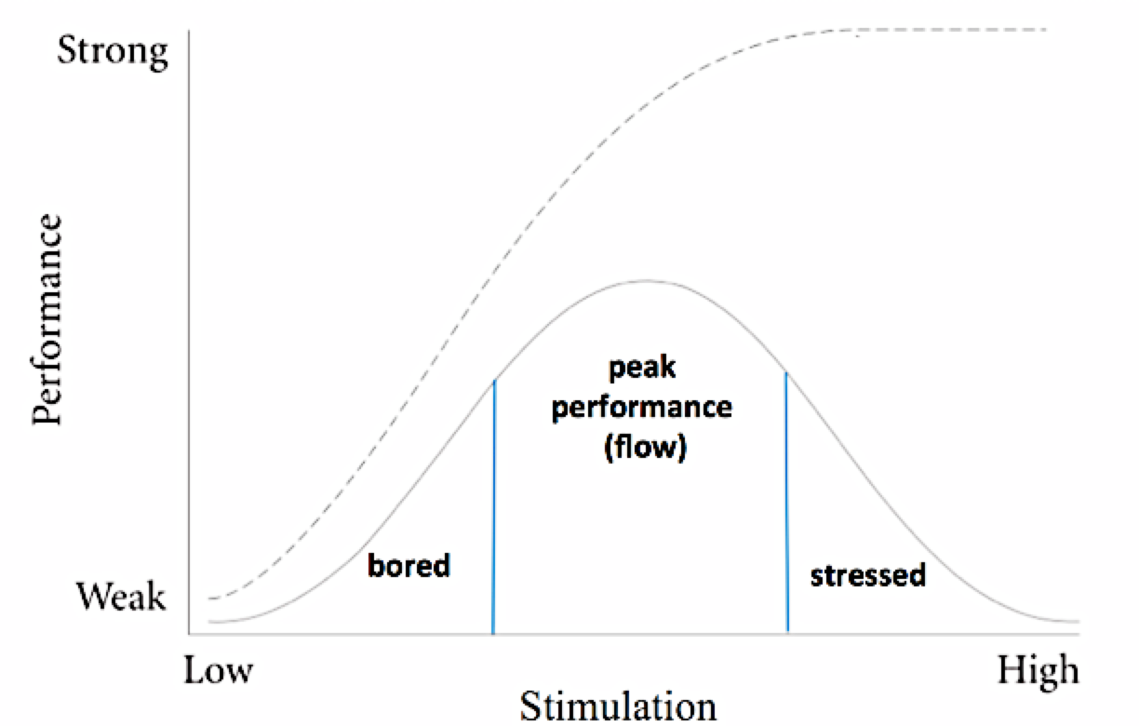
Stretch without breaking
Based on Yerkes & Dodson, 1908
Notes:
Let’s talk about another way of personalising goals.
OVER A 100 YEARS AGO 2 RESEARCHERS MADE AN INTERESTING DISCOVERY ABOUT THE RELATIONSHIP BETWEEN PSYCHOLOGICAL STIMULATION AND PERFORMANCE.
They found that for simple tasks the relationship is linear, and one can achieve high performance by increasing stimulation. For example, if I am a manager of a group of people carrying bricks and they’re moving too slowly, I could threaten to reduce their pay or promise them more money. The more carrot or stick I use the faster people will work – until they reach their peak.
However, for more sophisticated work – where you actually need to use your brain, make decisions, think logically and creatively, stimulation works very differently. That is, if on the one hand you are UNDERSTIMULATED, your performance is low and you are bored (as if you were doing physical work). On the other hand, if you are OVERSTIMULATED, your performance drops.
This is how stimulation works. Too little – people get bored and disengaged. Too much – people burn out.
When you set the goal, is it stretching enough for this particular employee, or is it too easy? How can you shape that goal with the amount of stretch that is just right?

Slide 29

29
v
Involve people from start to finish.
Focus on their strengths.
Create the right amount of stretch.
Make it personal
Notes:
Summarise key points.

Slide 30
Lens 3: Is it personal?
Finally, view the goal you wrote down against the following criteria:
Has the employee been closely involved in shaping this goal?
How does it play to their strengths?
Is it set at the right level of stretch?
Review and refine
Notes:
Run the exercise.

Slide 31
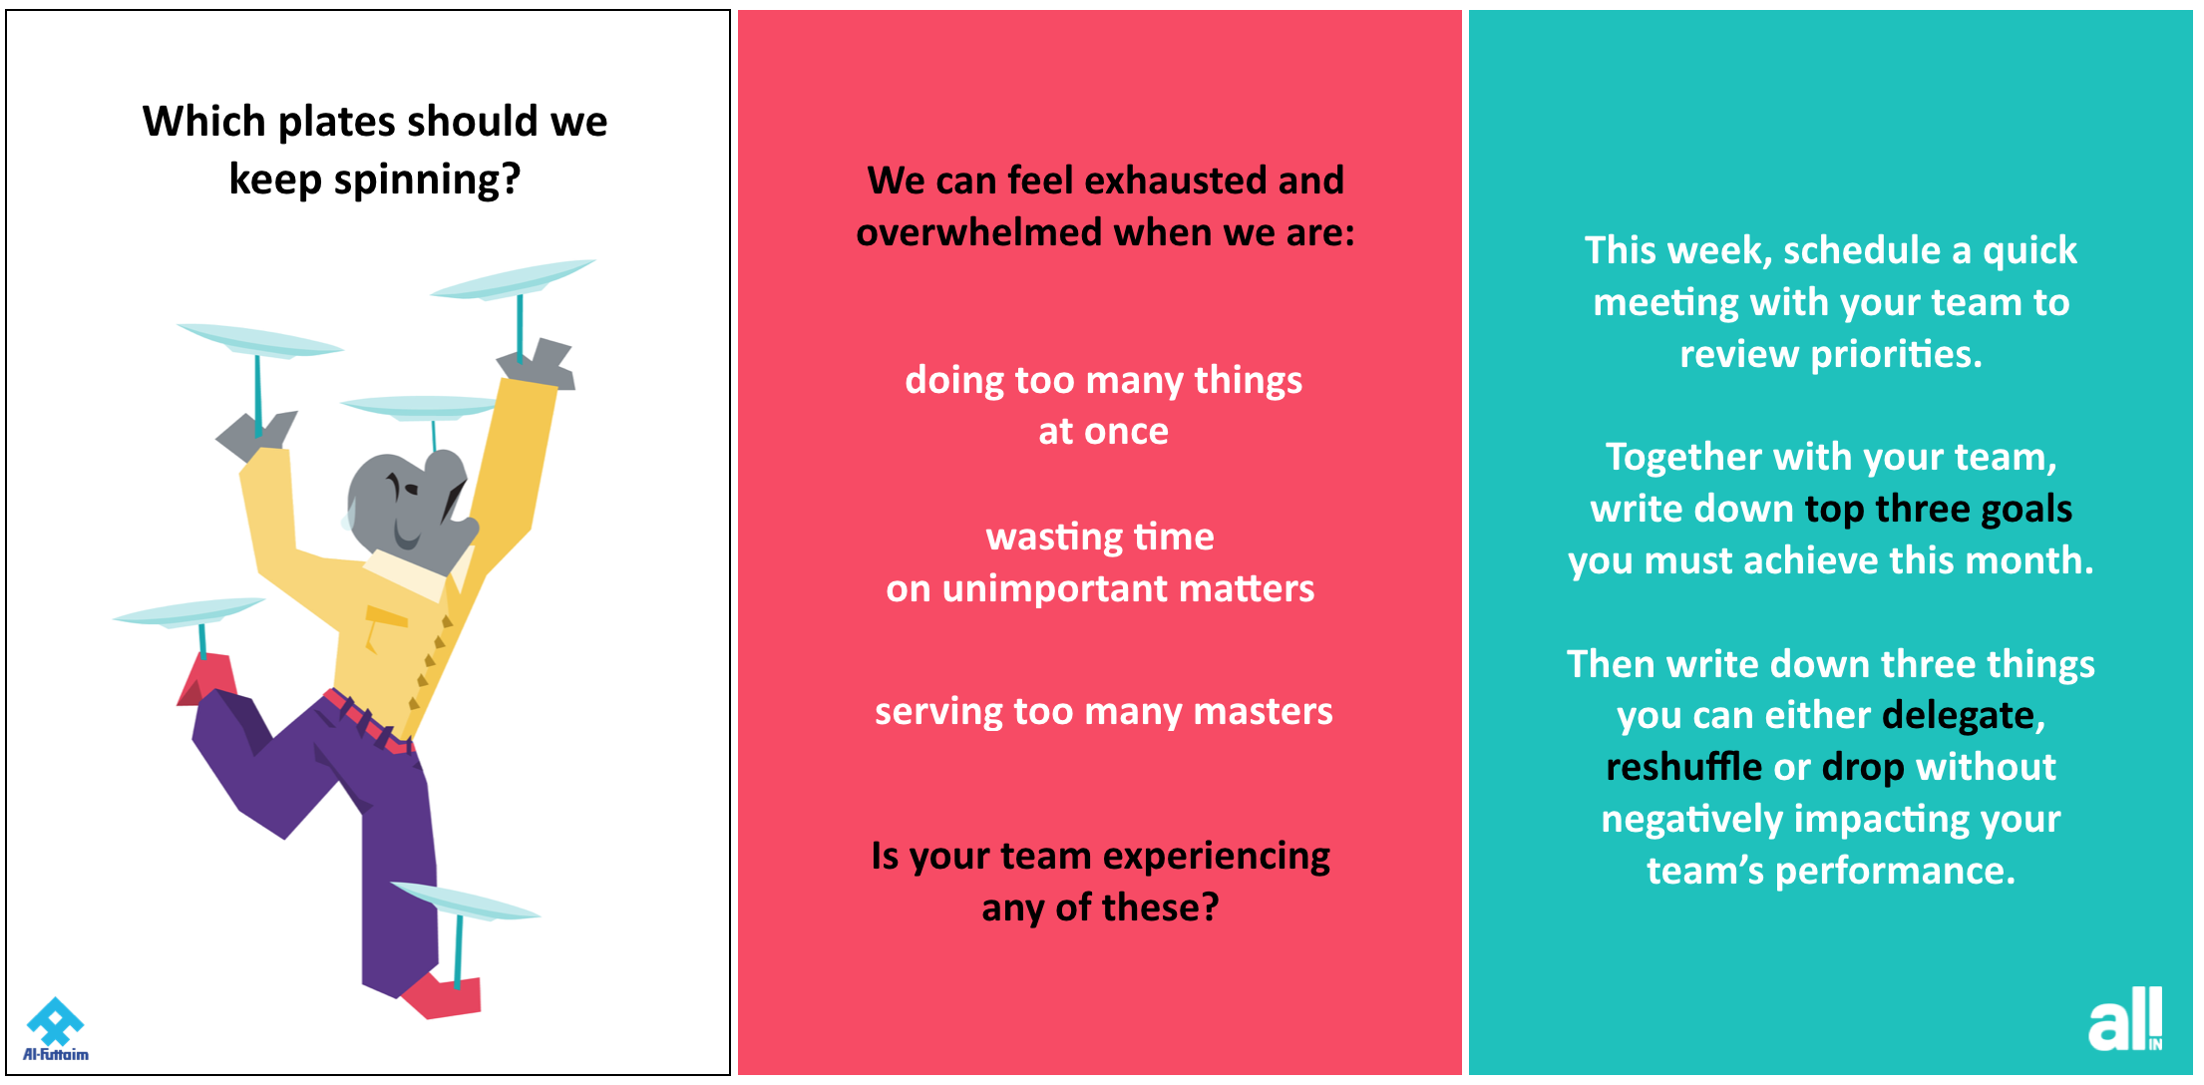
Weekly nudges

Slide 32
Closing comments

